Slide 1
Java
Strings

Slide 2
String related classes
Java provides four String related classes
java.lang package
String class: Storing and processing Strings but Strings created using the String class cannot be modified (immutable)
StringBuffer/StringBuilder class: Create flexible Strings that can be modified
java.util package
StringTokenizer class: Can be used to extract tokens from a String

Slide 3
String

Slide 4
String
String class provide many constructors and more than 40 methods for examining in individual characters in a sequence
You can create a String from a String value or from an array of characters.
String newString = new String(stringValue);
The argument stringValue is a sequence of characters enclosed inside double quotes
String message = new String (“Welcome”);
String message = “Welcome”;

Slide 5
String Constructors

Slide 6
String Length
Returns the length of a String
length()
Example:
String s1=“Hello”;
System.out.println(s1.length());

Slide 7
Extraction
Get the character at a specific location in a string
s1.charAt(1)
Get the entire set of characters in a string
s1.getChars(0, 5, charArray, 0)
public class StringTest {
public static void main(String[] args) {
String s = "Hello World";
char c1 = s.charAt(6);
System.out.println(c1);//W
char [] c2 = new char[5];
s.getChars(0, 5, c2, 0);
System.out.println(c2);//Hello
}
}

Slide 8
Extracting Substrings
substring method enable a new String object to be created by copying part of an existing String object
substring (int startIndex) ‐ copies the characters form the starting index to the end of the String
substring(int beginIndex, int endIndex) ‐ copies the characters from the starting index to one beyond the endIndex
public class StringSubstring {
public static void main(String[] args) {
String s = "Hello World";
String s1 = s.substring(6);
System.out.println(s1); //World
String s2 = s.substring(2,8);
System.out.println(s2); //llo Wo
}
}

Slide 9
String Comparisons
equals
Compare any two string objects for equality using lexicographical comparison. s1.equals(“hello”)
equalsIgnoreCase
s1.equalsIgnoreCase(s2)
compareTo
s1.compareTo(s2)
s1 > s2 (positive), s1 < s2 (negative), s1 = s2 (zero)

Slide 10
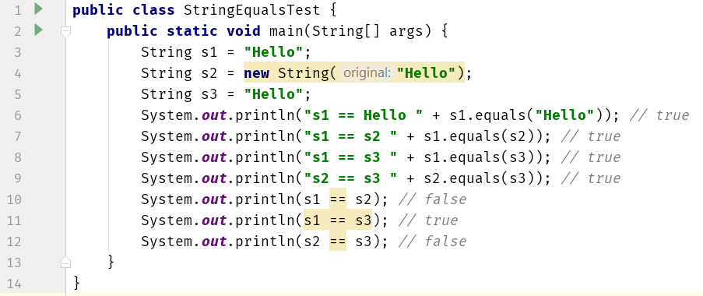
String Comparisons
For details have a look at section 1-4 from https://www.baeldung.com/java-string-pool

Slide 11
String Comparisons
regionMatches compares portions of two String objects for equality
s1.regionMatches (0, s2, 0, 5)
s1.regionMatches (true, 0, s2, 0, 5)
If the first argument is true, the method ignores the case of the characters being compared
startsWith and endsWith check whether a String starts or ends with a specified String
s1.startsWith (s2)
s1.endsWith (s2)

Slide 12
String Comparisons
public class StringTest {
public static void main(String[] args) {
String s = "Hello World";
String t = “hello ";
System.out.println(s.regionMatches(true, 0, t, 0, 6));//true
System.out.println(s.startsWith("Hello")); //true
System.out.println(s.endsWith("World")); //true
}
}

Slide 13
String Concatenation
Java provide the concat method to concatenate two strings.
s3 will be “Happy Birthday”
String s1 = new String (“Happy ”);
String s2 = new String (“Birthday”);
String s3 = s1.concat(s2);

Slide 14
String Search
Find the position of character/String within a String
int indexOf(char ch)
int lastIndexOf(char ch)
public class StringTest {
public static void main(String[] args) {
String s = "Hello World";
System.out.println(s.indexOf('o'));//4
System.out.println(s.lastIndexOf('o'));//7
}
}

Slide 15
String Conversions
Generally, the contents of a String cannot be changed once the string is created,
Java provides conversion methods
toUpperCase() and toLowerCase()
Converts all the characters in the string to lowercase or uppercase
trim()
Eliminates blank characters from both ends of the string
replace(oldChar, newChar)
Replaces a character in the string with a new character

Slide 16
String to Other Conversions
The String class provides valueOf methods for converting a character, an array of characters and numeric values to strings
valueOf method take different argument types

Slide 17
String to Other Conversions
Type | To String | From String
boolean | String.valueOf(boolean) | Boolean.parseBoolean(String)
byte | String.valueOf(int) | Byte.parseByte(String, int base)
short | String.valueOf(int) | Short.parseShort (String, int base)
Int | String.valueOf(int) | Integer.parseInt (String, int base)
long | String.valueOf(long) | Long.parseLong (String, int base)
float | String.valueOf(float) | Float.parseFloat(String)
double | String.valueOf(double) | Double.parseDouble(String)

Slide 18
String Conversion Example
To convert an int to a String (3 different ways):
int n = 123;
String s1 = Integer.toString(n);
String s2 = String.valueOf(n);
String s3 = n + "";
To convert a string to an int:
String s = “1234”;
int n = Integer.parseInt(s);

Slide 19
String Split
split() method splits a String against given regular expression and returns a character array
public class StringSplitTest {
public static void main(String[] args) {
String test = "abc,,def,123";
String[] out = test.split(",");
System.out.println(out.length);
for (int i = 0; i < out.length; i++) {
System.out.println(out[i]);
}
}
}

Slide 20
StringTokenizer
Break a string into pieces (tokens) so that contained information can be retrieved and processed
Specify a set of characters as delimiters when constructing a StringTokenizer object
StringTokenizer class is available since JDK 1.0 and the String.split() is available since JDK 1.4
String.split() does produce empty tokens, but StringTokenizer doesn't
StringTokenizer is a legacy class, retained for compatibility reasons, the use is discouraged!

Slide 21
StringTokenizer
Constructors
StringTokenizer(String str, String delim)
StringTokenizer(String str)
Methods
hasMoreToken() ‐ Returns true if there is a token left in the string
nextToken() ‐ Returns the next token in the string
nextToken(String delim) ‐ Returns the next token in the string after reseting the delimiter to delim
countToken( ) ‐ Returns the number of tokens remaining in the string tokenizer

Slide 22
StringTokenizer

Slide 23
StringBuffer/StringBuilder

Slide 24
StringBuffer
Can be used wherever a string is used
More flexible than String
Can add, insert, or append new contents into a string buffer
The StringBuffer class has three constructors and more than 30 methods for managing the buffer and for modifying strings in the buffer
Every StringBuffer is capable of storing a number of characters specified by its capacity

Slide 25
StringBuffer Constructors
public StringBuffer()
No characters in it and an initial capacity of 16 characters
public StringBuffer(int length)
No characters in it and an initial capacity specified by the length argument
public StringBuffer(String string)
Contains String argument and an initial capacity of the buffer is 16 plus the length of the argument

Slide 26
StringBuilder
The functionalities of StringBuilder is the same as StringBuffer, but StringBuilder is faster
StringBuffer is synchronized, StringBuilder is not
StringBuffer came first
Sun was concerned with correctness under all conditions, they made it synchronized to make thread-safe just in case
StringBuilder came later
Drop-in replacement for StringBuffer without the synchronization, not thread-safe

Slide 27
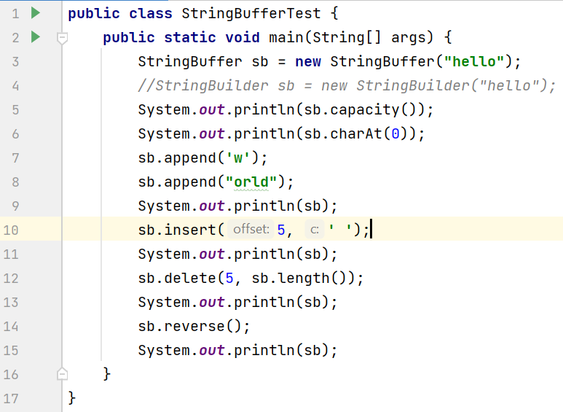
StringBuffer/StringBuilder

